Slide 1

Flows
By Shawn Ashton, Daniel Slaugh, Matthew Blomquist, Taylor Matheny, James Call, Nick Campbell

Slide 2

What is FLOW?
The order information is perceived.
How the eye “flows” through the page.

Slide 3

What should a flow look like?
The most important information first. [2]
We use different flows to accomplish different goals in our paper. [2]

Slide 4

Main types of flow
Process flow
Work flow
Data Flow
Control Flow
Functional Flow

Slide 5

Process Flow
Shawn

Slide 6
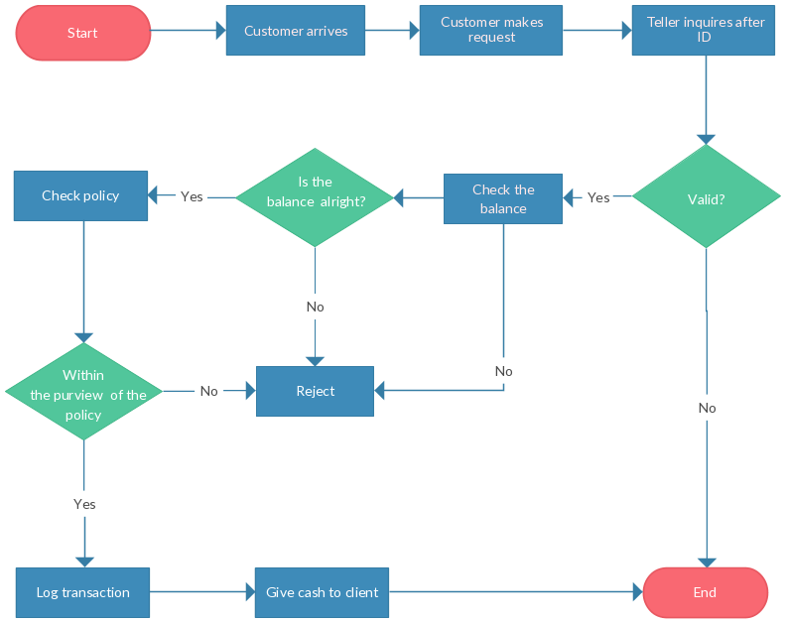
Process Flow: What is it?
Bank Teller process flow
Closely associated with flowcharts. Also called process flow diagram

Slide 7

PROCESS FLOW: what is the point?
To document the process for better understanding.
Standardize the process.
Studying efficiency.
To communicate and collaborate concepts.
Process flow - "A method of visually documenting the stages involved in performing a certain business procedure."

Slide 8

Work Flow
Daniel

Slide 9
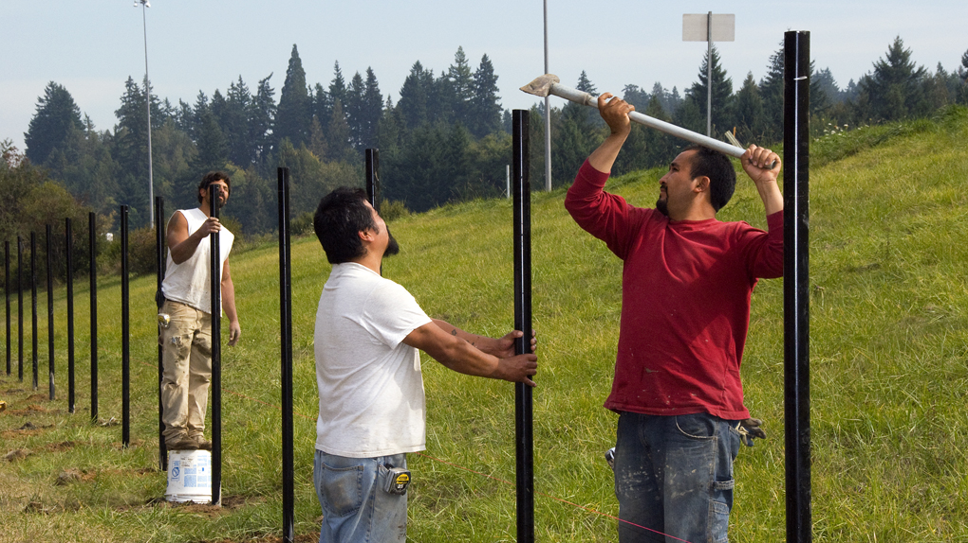
Work Flow: What is it?
This Photo by Unknown author is licensed under CC BY-SA.

Slide 10
Work Flow vs. Process Flow
Process is a sequence of tasks that exist naturally and flows intuitively.
workflow is a way to make this sequence more productive and efficient. A workflow is analyzed, planned, modeled

Slide 11
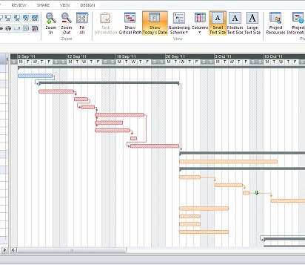
Gantt Chart

Slide 12

Data Flow
Matthew

Slide 13
Data flow is the movement of, or path taken by data through a computer or device.
A data-flow may represent a single data element such the Customer ID or it can represent a set of data element (or a data structure).

Slide 14
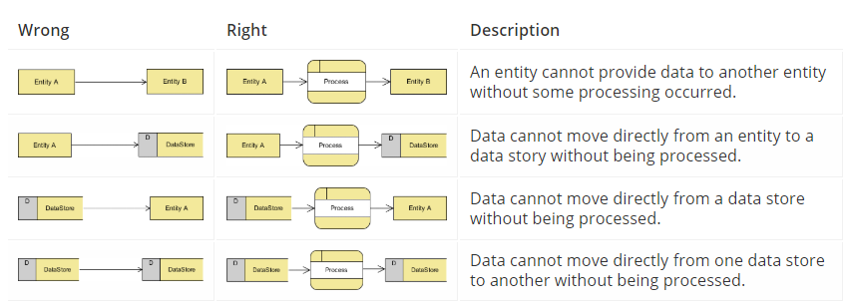
One of the rule for developing Data Flow Diagram is that all flow must begin with and end at a processing step.
Notes:
This is quite logical, because data can't transform on its own with being process. By using the thumb rule, it is quite easily to identify the illegal data flows and correct them in a DFD.

Slide 15
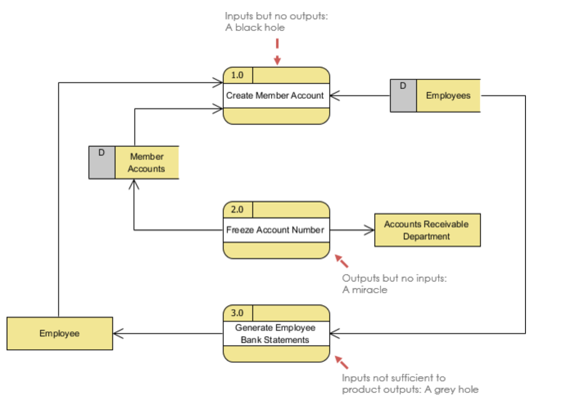
When the outputs from one processing step do not match its inputs and they can be classified as:
Other frequently-made mistakes
Inputs but no outputs: A black hole
Outputs but no inputs: A miracle
Inputs not sufficient to product outputs:
A gray hole

Slide 16
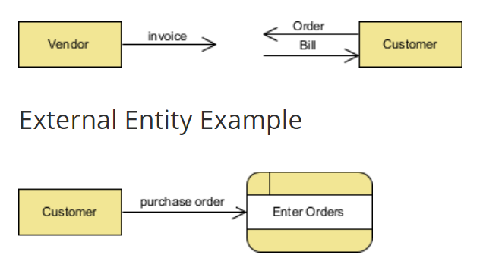
- Supply data or receive data - They don’t process data
External Entity

Slide 17
A data store or data repository is used in a data-flow diagram to represent a situation when the system must retain data because one or more processes need to use the stored data in a later time.
Data Store

Slide 18

Control Flow
James

Slide 19
In computer programming, control flow or flow of control is the order function calls, instructions, and statements are executed or evaluated when a program is running.
Many programming languages have what are called control flow statements, which are used to determine what section of code is run in a program at any given time such as...
If Statements
Switch Statements
Loops
Function Calls

Slide 20
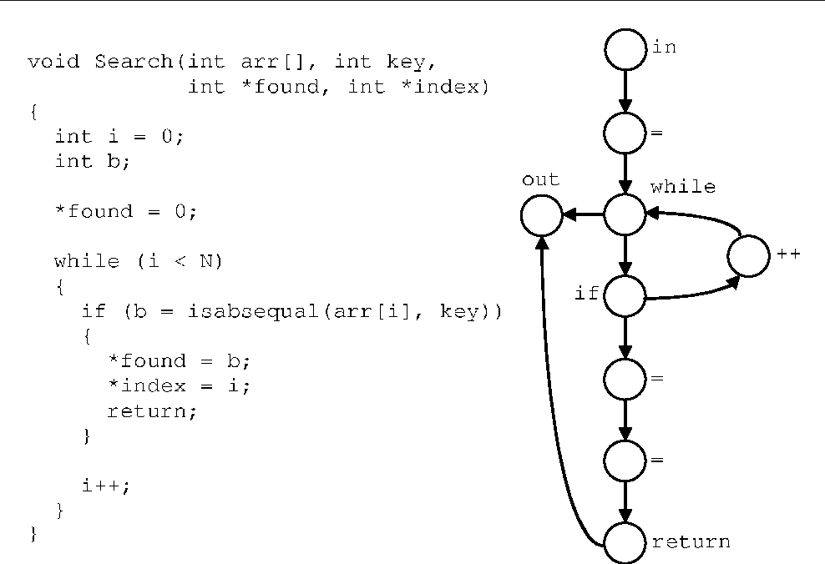

Slide 21

Functional Flow
Nick

Slide 22
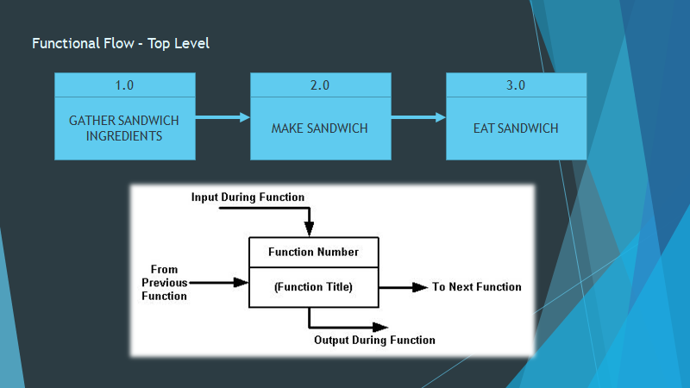
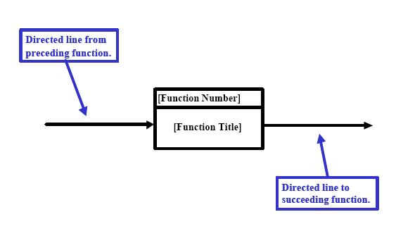

Slide 23
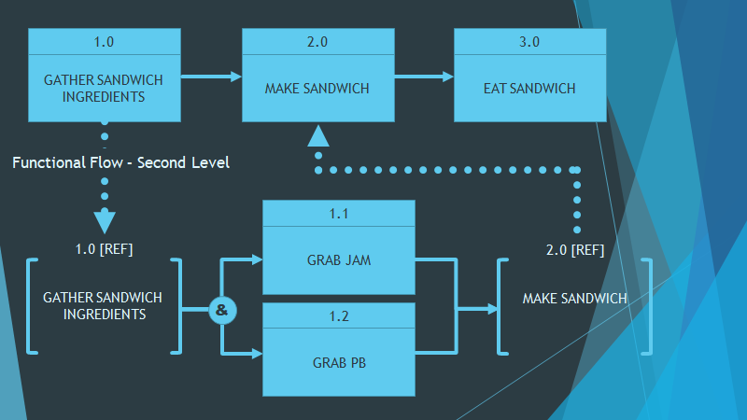

Slide 24
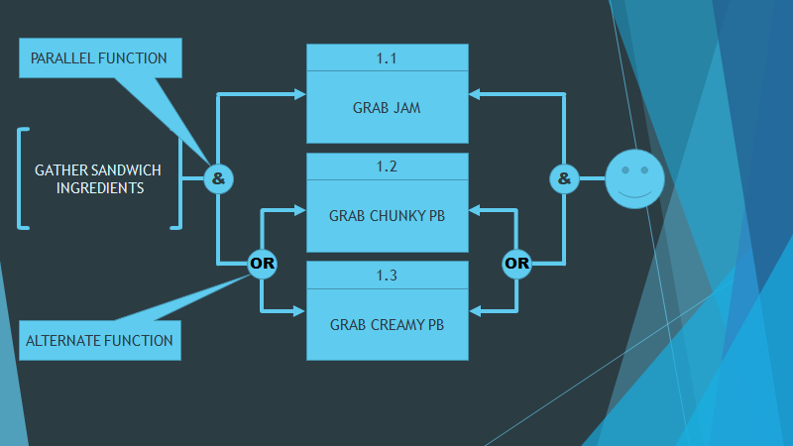
1.0 [REF]

Slide 25

Sources
[1] “What Is Process Flow? Definition and Meaning.” BusinessDictionary.com, www.businessdictionary.com/definition/process-flow.html.
[2] Bradley, Steven. “Design Principles: Compositional Flow And Rhythm.” Smashing Magazine, 29 Apr. 2015, www.smashingmagazine.com/2015/04/design-principles-compositional-flow-and-rhythm/.
[3] “What Is a Process Flow Diagram.” Lucidchart, www.lucidchart.com/pages/process-flow-diagrams.
[4] Gold, Robert. “Control Flow Graphs and Code Coverage - Semantic Scholar.” Semantic Scholar, 1 Jan. 1970, www.semanticscholar.org/paper/Control-flow-graphs-and-code-coverage-Gold/0734b520a87c853dfdea2f857bfc3600381c124d.
[5] “What Is Control Flow?” Computer Hope, Computer Hope, 13 Nov. 2018, www.computerhope.com/jargon/c/contflow.htm.

Slide 26

Sources
[6] “What Is Data Flow?” Computer Hope, Computer Hope, 2 Oct. 2017, www.computerhope.com/jargon/d/dataflow.htm.
[7] What Is Data Flow Diagram?, www.visual-paradigm.com/guide/data-flow-diagram/what-is-data-flow-diagram/.
[8] “What Are the Differences between Workflow and Processes?” HEFLO BPM, 11 Sept. 2018, www.heflo.com/blog/bpm/workflow-and-processes/.
[9] “Functional Flow Block Diagram.” Wikipedia, Wikimedia Foundation, 4 Oct. 2018, https://en.wikipedia.org/wiki/Functional_flow_block_diagram.
[10] Browne, Chris. YouTube, YouTube, 16 Mar. 2013, www.youtube.com/watch?v=Ii1MI68MKDs.

Slide 27

Questions
What are the different types of flow? (choose all that apply)
Functional Flow
Memory Flow
Process Flow
Flowception
Data Flow
Procedural Flow
Direct Flow
Control Flow
Work Flow

Slide 28
Questions
Work Flow (Multiple Select fill in the blank)
What is the difference between process flow and workflow
1.__________ is a sequence of tasks that exist naturally
2.__________ flows intuitively.
3.__________ is a way to make this sequence more productive and efficient.
4.A _____________ is analyzed, planned, modeled

Slide 29
QUESTIONS...
Which of the following are reasons to have a PFD (process flow diagram)
1 To document the process for better understanding.
2 Standardize the process.
3 To teach yourself the flow
4 It is required by Intel and IEEE

